Slide 1


Financial Ratios Analysis for Early Detection of Audit Risk
DSML 2025

Slide 2
Auditing: Current Challenges
Problem:
project objective:
Auditors struggle to quickly identify companies at risk of bankruptcy, which can delay effective audit planning and increase uncertainty.
Analyze key financial ratios to reveal patterns that distinguish healthy companies from those in distress, helping auditors assess risk more accurately and efficiently.

Slide 3

What Are Financial Ratios?
Think of financial ratios like health indicators for companies. Just like doctors use blood pressure, heart rate, and temperature to assess your health, auditors use financial ratios to assess a company's financial health.
Identifying these "financially unhealthy companies" helps auditors focus their attention where it is most needed.

Slide 4
Company Bankruptcy Prediction Dataset
Description:
Characteristics:
6,819 companies
95 financial features/ratios
It includes key ratios like profitability, liquidity, solvency, and efficiency .
Bankruptcy data from the Taiwan Economic Journal for the years 1999–2009.
Source: Kaggle
Link: https://www.kaggle.com/datasets/fedesoriano/company-bankruptcy-prediction
Analyzing these ratios, we can find patterns that can help detect financial problems earlier and make audits more focused and effective.

Slide 5


Understanding and Cleaning data
this project will focus on the key ratios used to distinguish a healthy company from bankrupt one:
'Bankrupt?',
'ROA',
'Current Ratio',
'Debt Ratio',
'Total Asset Turnover'
#Creating a new DataFrame with only the key ratios

Slide 6
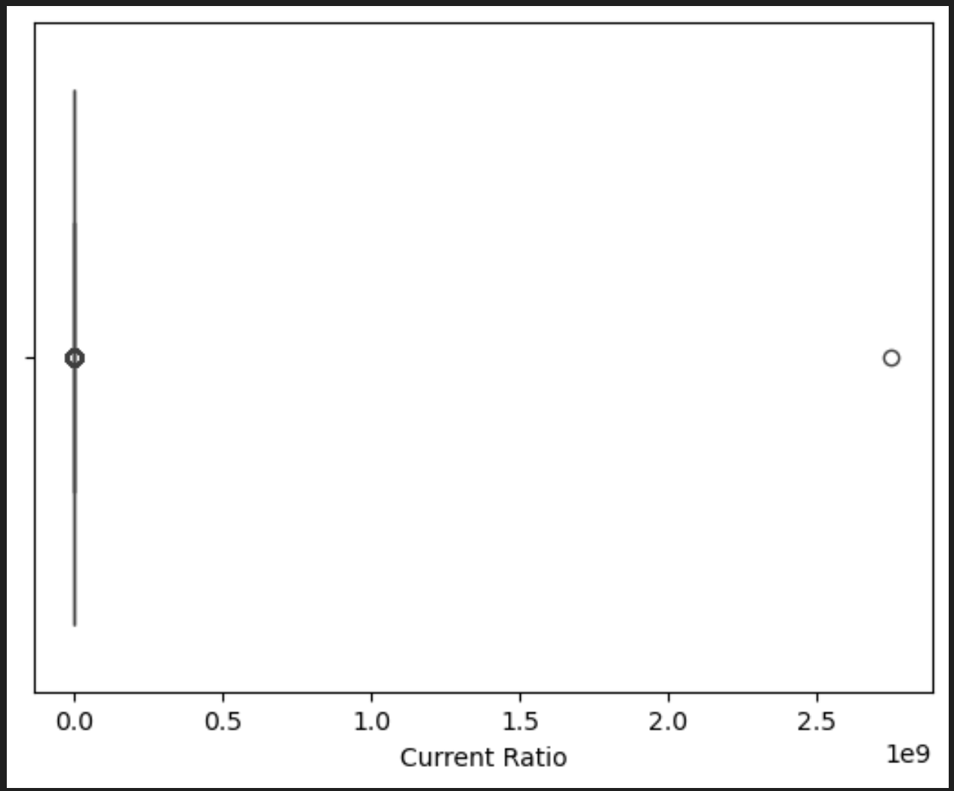
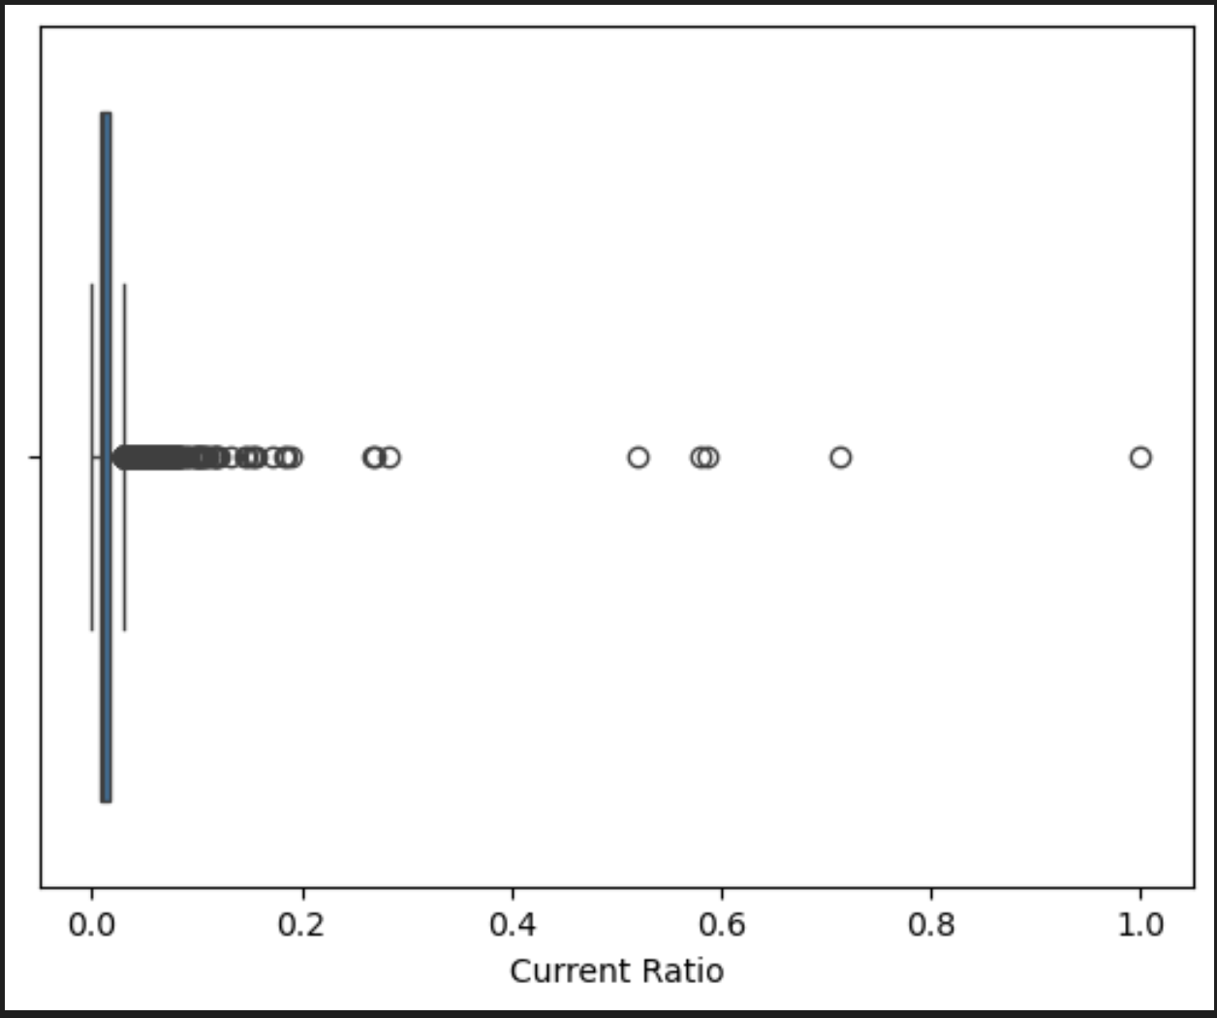
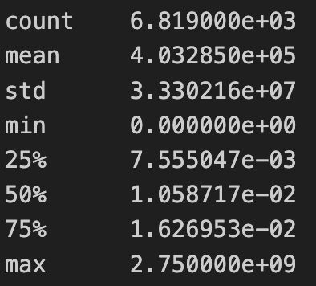
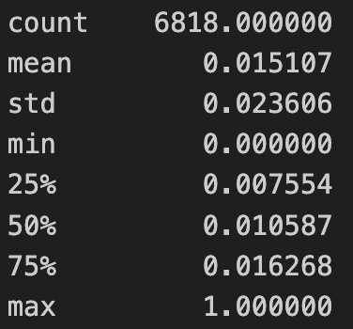

💧 Company can pay its short-term debts
Above 1 → good liquidity.
Very low → trouble paying debts.
Extremely high → suspicious or unrealistic.
Created a new Data Frame with key ratios: Bankrupt? ROA, Current Ratio, Debt Ratio, Total Asset Turnover
Analyzed tendency in "Current Ratio ” = Current Assets / Current Liabilities
Detected an outlier (more than two billion)
After
Before

Slide 7
Exploratory Data Analysis
this project will focus on the key ratios used to distinguish a healthy company from bankrupt one:
'Bankrupt?',
'ROA',
'Current Ratio',
'Debt Ratio',
'Total Asset Turnover'
#Creating a new DataFrame with only the key ratios

Slide 8
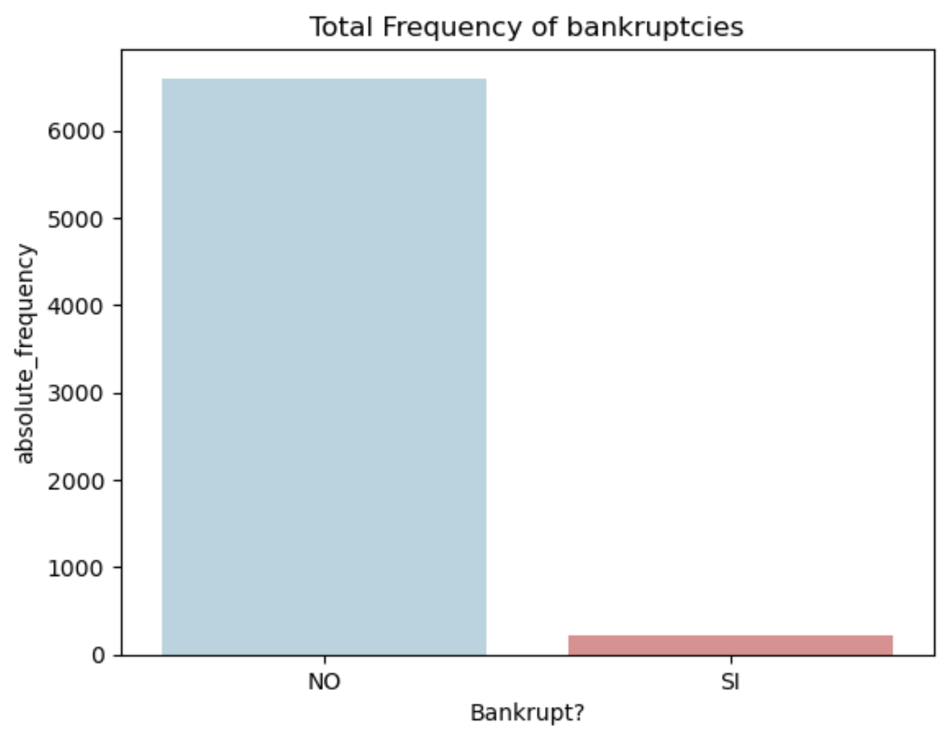
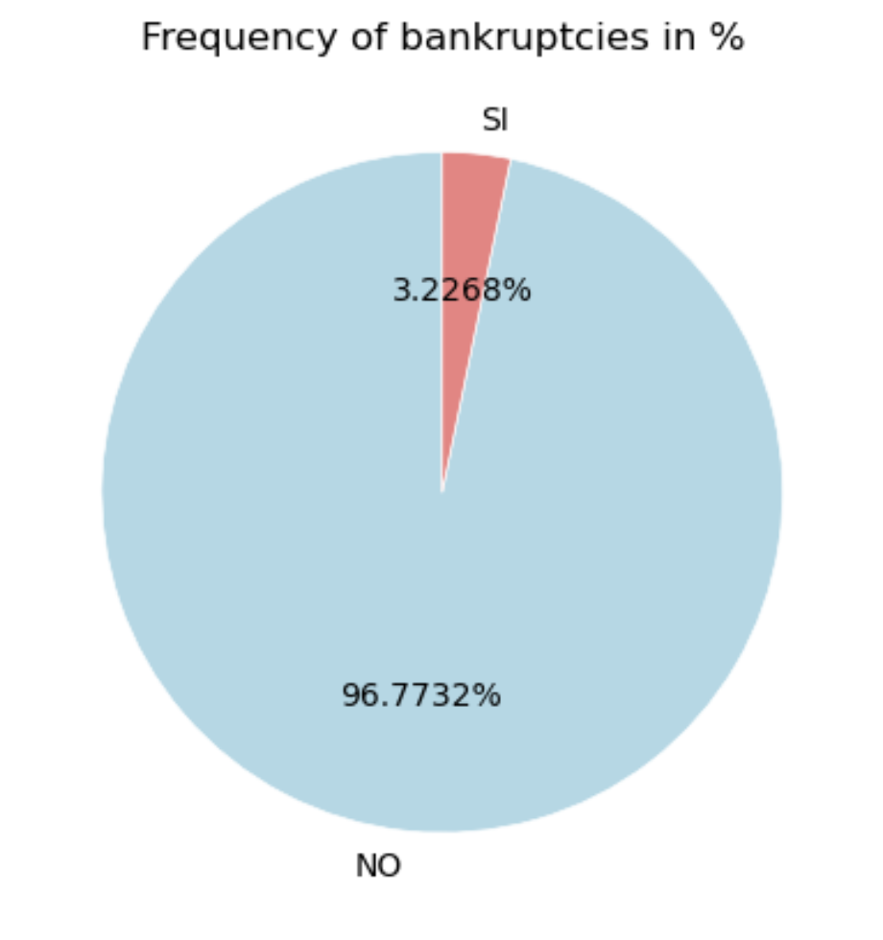
categorical variable

Slide 9
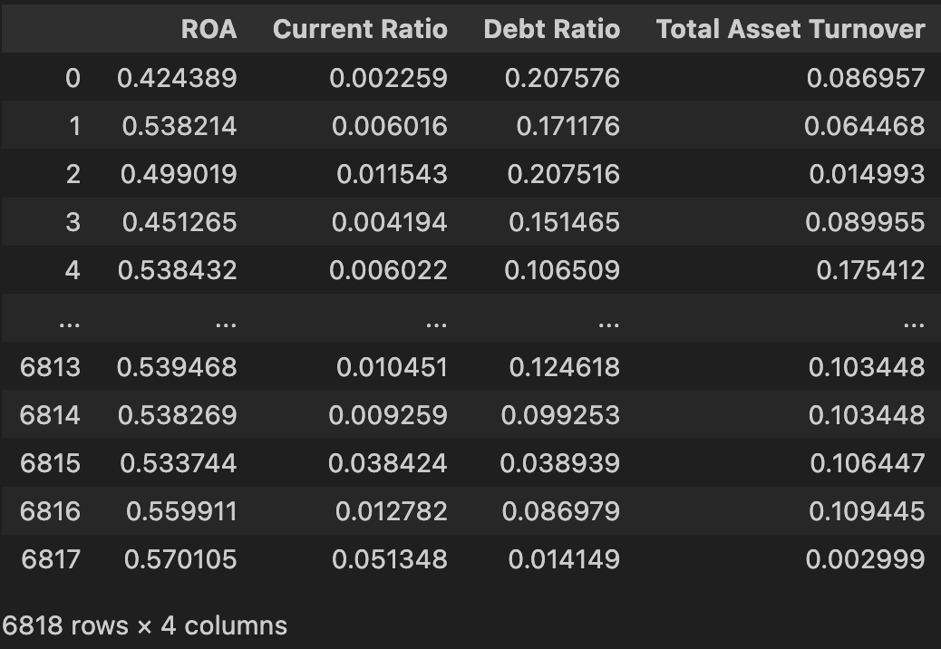
Numerical variables
Profitability Ratio - ROA (Return on Assets) = Net Income / Total Assets
Liquidity Ratio - Current Ratio= Current Assets / Current Liabilities
Solvency Ratio – Debt ratio = Total Liabilities / Total Assets
Efficiency Ratio - Total Asset Turnover = Revenue / Total Assets

Slide 10
Statistical analysis and graphics of ratios
this project will focus on the key ratios used to distinguish a healthy company from bankrupt one:
'Bankrupt?',
'ROA',
'Current Ratio',
'Debt Ratio',
'Total Asset Turnover'
#Creating a new DataFrame with only the key ratios

Slide 11
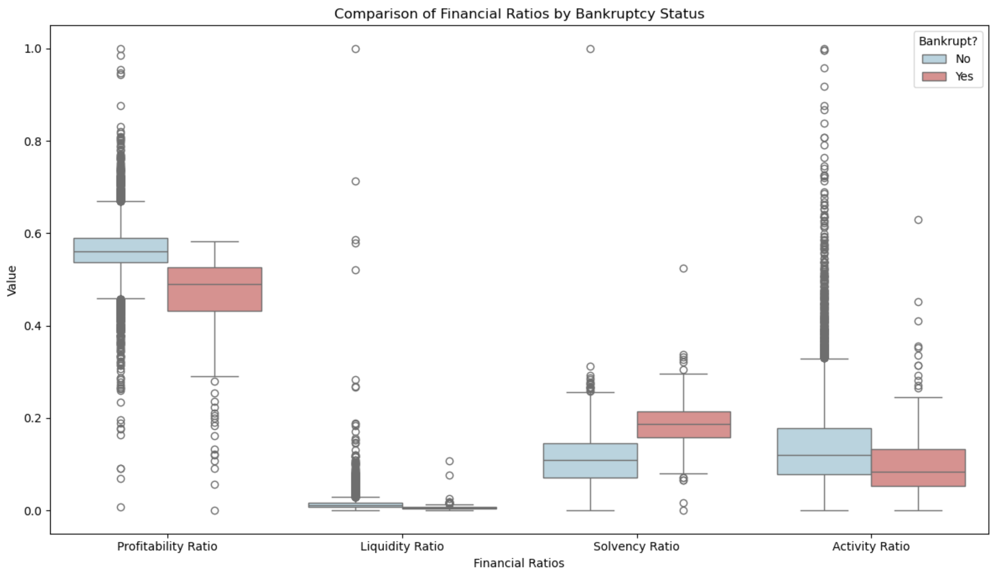
measures of central tendency

Slide 12
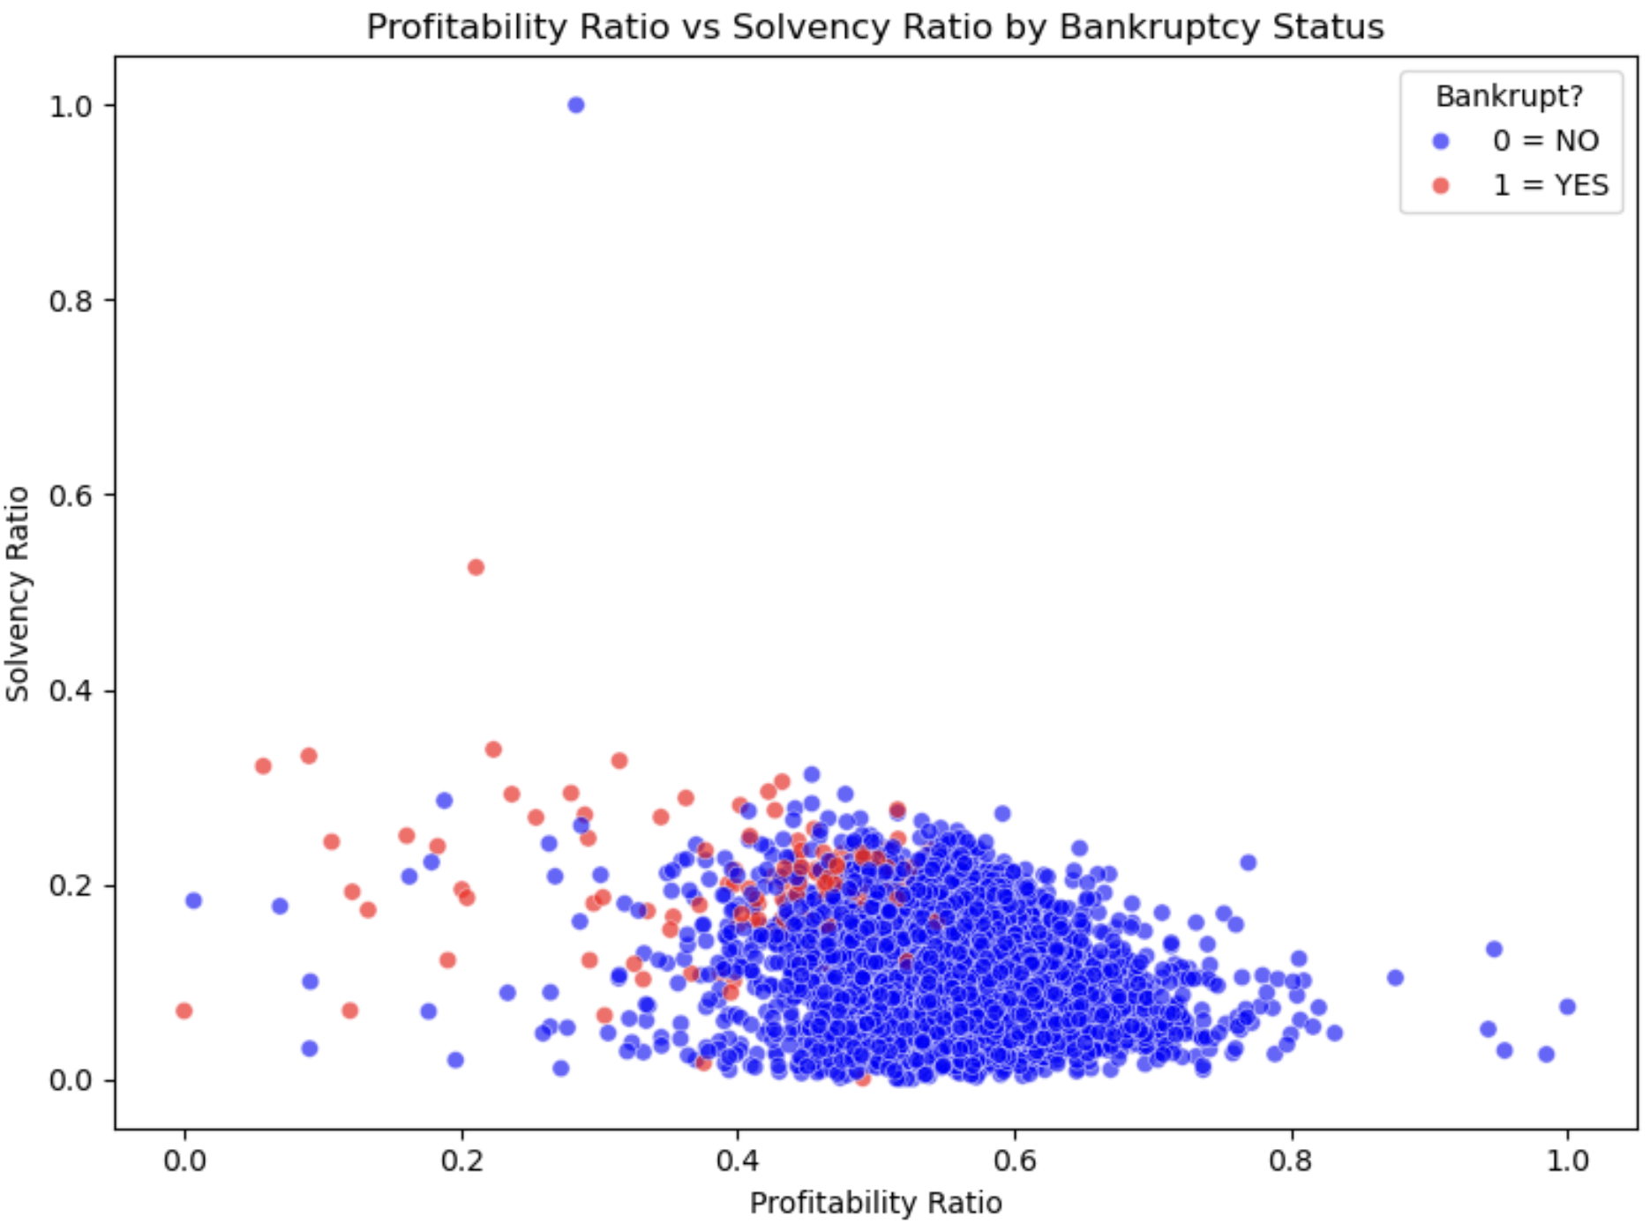

Patterns That Reveal Financial Health
Bankrupt firms often combine low profitability with high debt levels — a red flag for auditors.

Slide 13
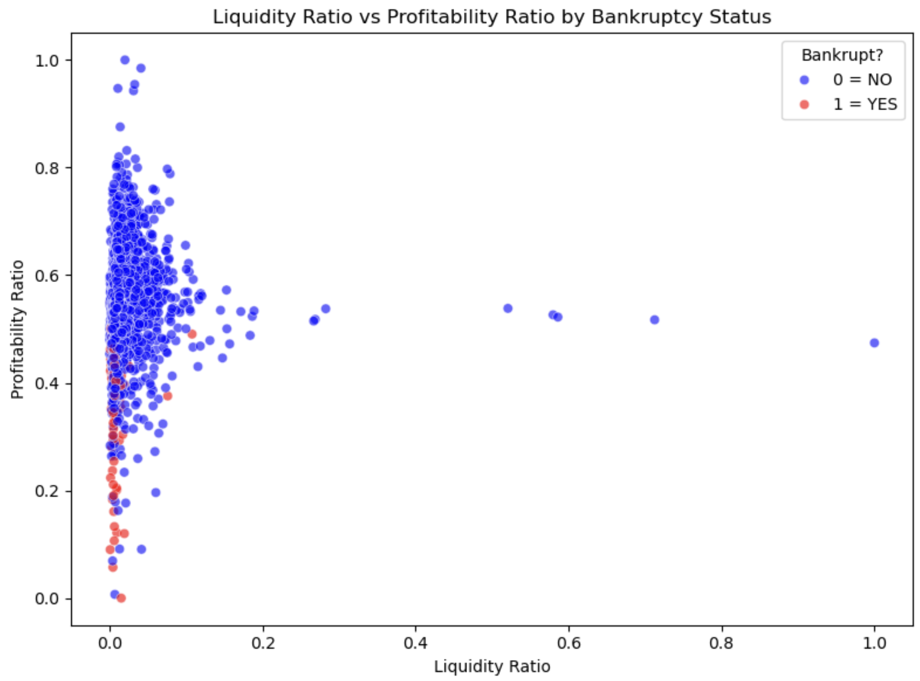

Patterns That Reveal Financial Health
Bankrupt companies tend to have both lower liquidity and lower profitability, indicating financial stress on both fronts

Slide 14
Conclusion
Key financial ratios reveal clear patterns that distinguish healthy companies from bankrupt ones, supporting early audit risk assessment.

